Slide 1
BITS Pilani presentation
K. Venkata Ratnam
Mathematics

Slide 2
Course Number : SS ZC416
Course Title: MATHEMATICAL FOUNDATIONS
FOR DATA SCIENCE
Lecture No. :11

Slide 3
Floor and ceiling functions
The floor function assigns to the real number x the largest integer that is less than or equal to x. The value of the floor function at x is denoted by x. The ceiling function assigns to the real number x the smallest integer that is greater than or equal to x. The value of the ceiling function at x is denoted by x.

Slide 4
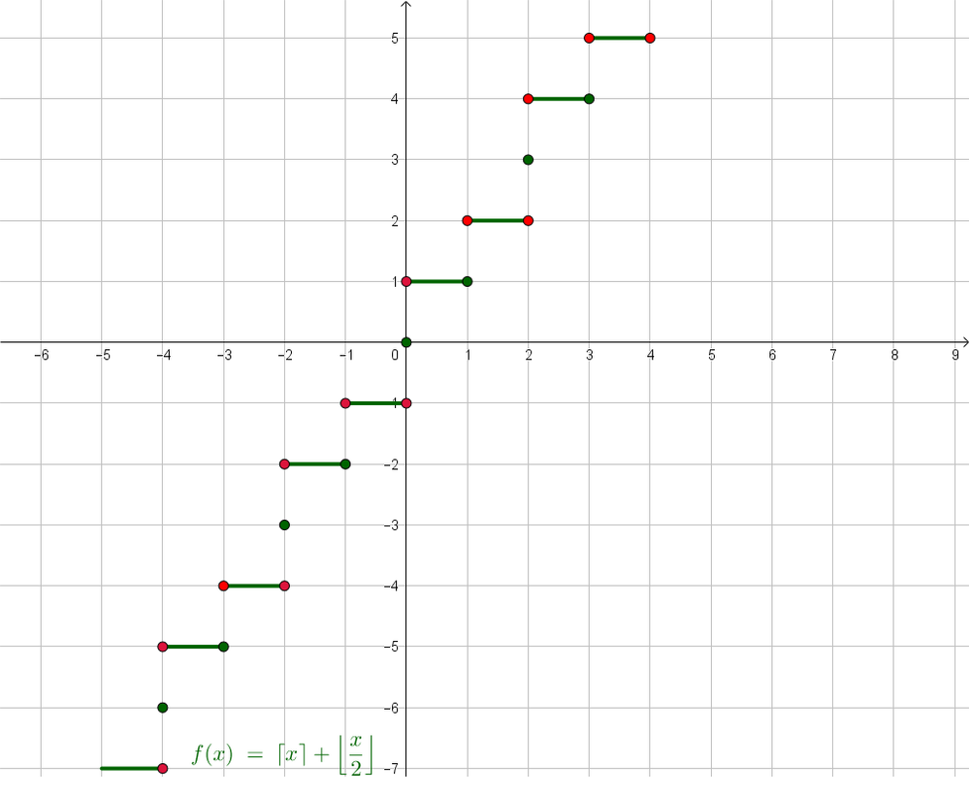
Graph of a function

Slide 5
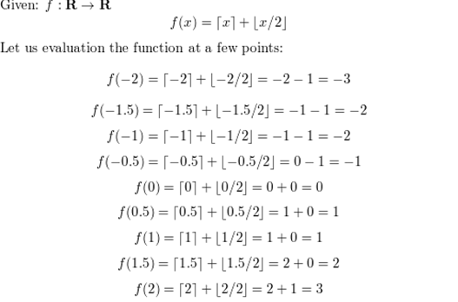

Slide 6
Relations and their Properties

Slide 7
Relationships between elements of sets:
A business and its telephone number.
An employee and his or her salary.
A person and a relative, and so on.
A positive integer and one that it divides.
An integer and one that it is congruent to modulo 5.
A real number and one that is larger than it .
A real number x and the value f (x) where f is a function.
A program and a variable it uses.
A computer language and a valid statement in this language
often arise in computer science.
.

Slide 8
Real time problems
Determining which pairs of cities are linked by airline flights in a network.
Finding a viable ( feasible) order for the different phases of a complicated project.
Producing a useful way to store information in computer databases.

Slide 9
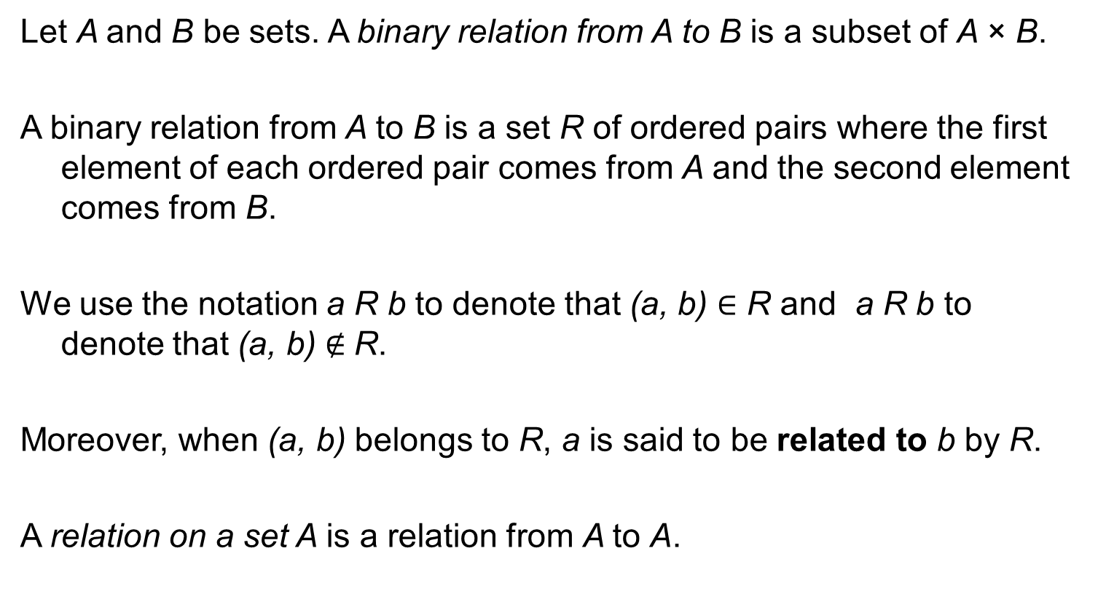
Definition
Let A and B be sets. A binary relation from A to B is a subset of A × B.
A binary relation from A to B is a set R of ordered pairs where the first element of each ordered pair comes from A and the second element comes from B.
We use the notation a R b to denote that (a, b) ∈ R and a R b to denote that (a, b) $∉$R.
Moreover, when (a, b) belongs to R, a is said to be related to b by R.
A relation on a set A is a relation from A to A.

Slide 10
Relation
A relation can be used to express a one-to-many relationship between the elements of the sets A and B, where an element of A may be related to more than one element of B.
A function represents a relation where exactly one element of B is related to each element of A.
Relations are a generalization of graphs of functions;

Slide 11
Example
List the 16 different relations on the set {0,1}.
A relation on a set A is the subset of
A X A = {(0, 0), (0, 1), (1, 0), (1, 1)}
Relations: 1.𝛷 2.{(0,0)} 3. {(0,1)} 4. {(1,0)} 5. {(1,1)} 6.{(0,0), (0,1)} 7. {(0,0), (1,0)} 8. {(0,0), (1,1)} 9.{(0,1), (1,0)} 10. {(0,1), (1,1)} 11. {(1,0), (1,1)} 12.{(0,0), (0,1), (1,0)} 13. {(0,0), (0,1), (1,1)} 14.{(0,0), (1,0), (1,1)} 15. {(0,1), (1,0), (1,1)} 16.{(0,0), (0,1), (1,0), (1,1)}

Slide 12
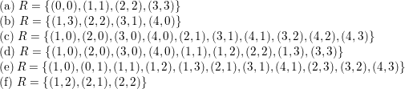
List the ordered pairs in the relation R from A = {0, 1, 2, 3, 4} to B = {0, 1, 2, 3}, where (a, b) ∈ R if and only if
a = b.
a + b = 4.
c) a > b.
d) a / b.
e) gcd(a, b) = 1.
f ) lcm(a, b) = 2.

Slide 13
Properties of relations
A relation R on a set A is called reflexive if (a, a) ∈ R for every element a ∈ A.
A relation R on a set A is called symmetric if (b, a) ∈ R whenever (a, b) ∈ R, for all a, b ∈ A.
A relation R on a set A such that for all a, b ∈ A, if (a, b) ∈ R and (b, a) ∈ R, then a = b is called antisymmetric.

Slide 14
Defintion
A relation R on a set A is called transitive if whenever (a, b) ∈ R and (b, c) ∈ R, then (a, c) ∈ R, for all a, b, c ∈ A.
Let R be a relation from a set A to a set B and S a relation from B to a set C.
The composite of R and S is the relation consisting of ordered pairs (a, c), where a ∈ A, c ∈ C, and for which there exists an element b ∈ B such that (a, b) ∈ R and (b, c) ∈ S.
We denote the composite of R and S by S ◦R.

Slide 15
Definition
Let R be a relation on the set A. The powers R^{n}, n = 1, 2, 3, . . . , are defined recursively by R¹ = R and R^{n+1} = R^{n} ◦ R.
The definition shows that R² = R ◦R, R³ = R² ◦R = (R ◦ R)◦R, and so on.

Slide 16
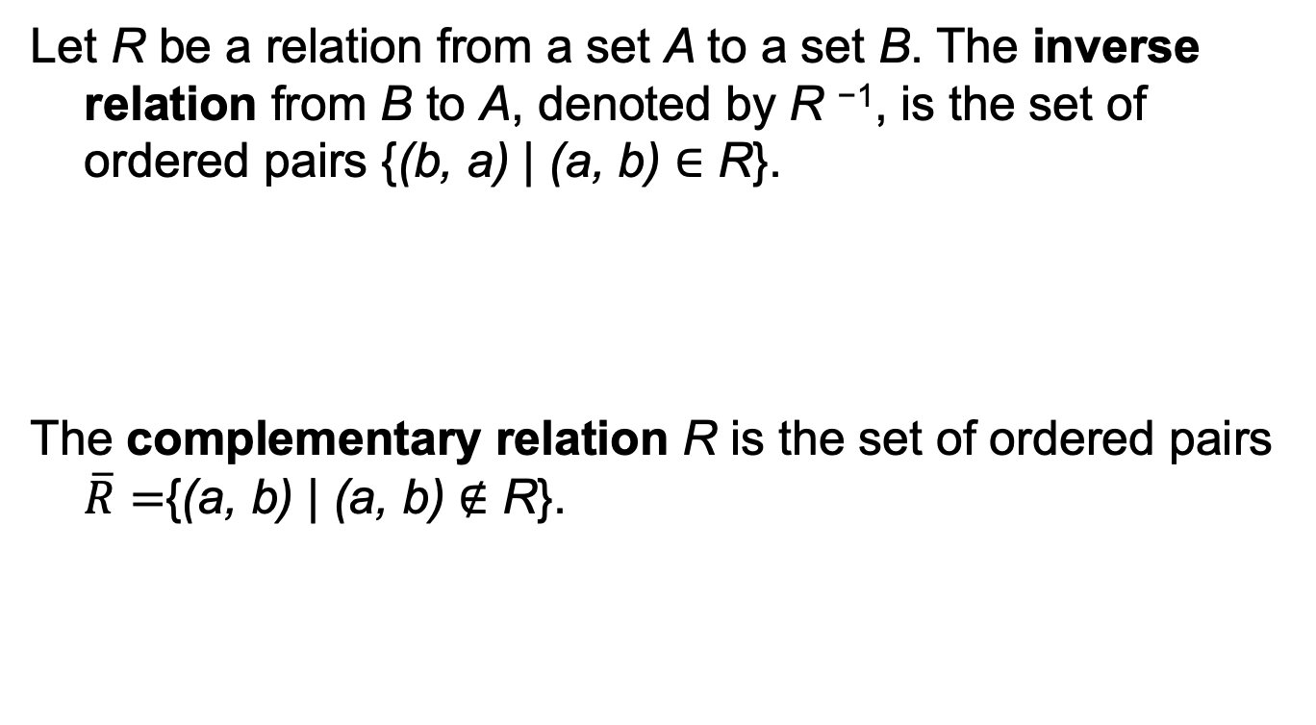
Inverse and complement of a relation
Let R be a relation from a set A to a set B. The inverse relation from B to A, denoted by R ⁻¹, is the set of ordered pairs {(b, a) | (a, b) ∈ R}.
The complementary relation R is the set of ordered pairs $\overline{R}=${(a, b) | (a, b) $∉$ R}.

Slide 17
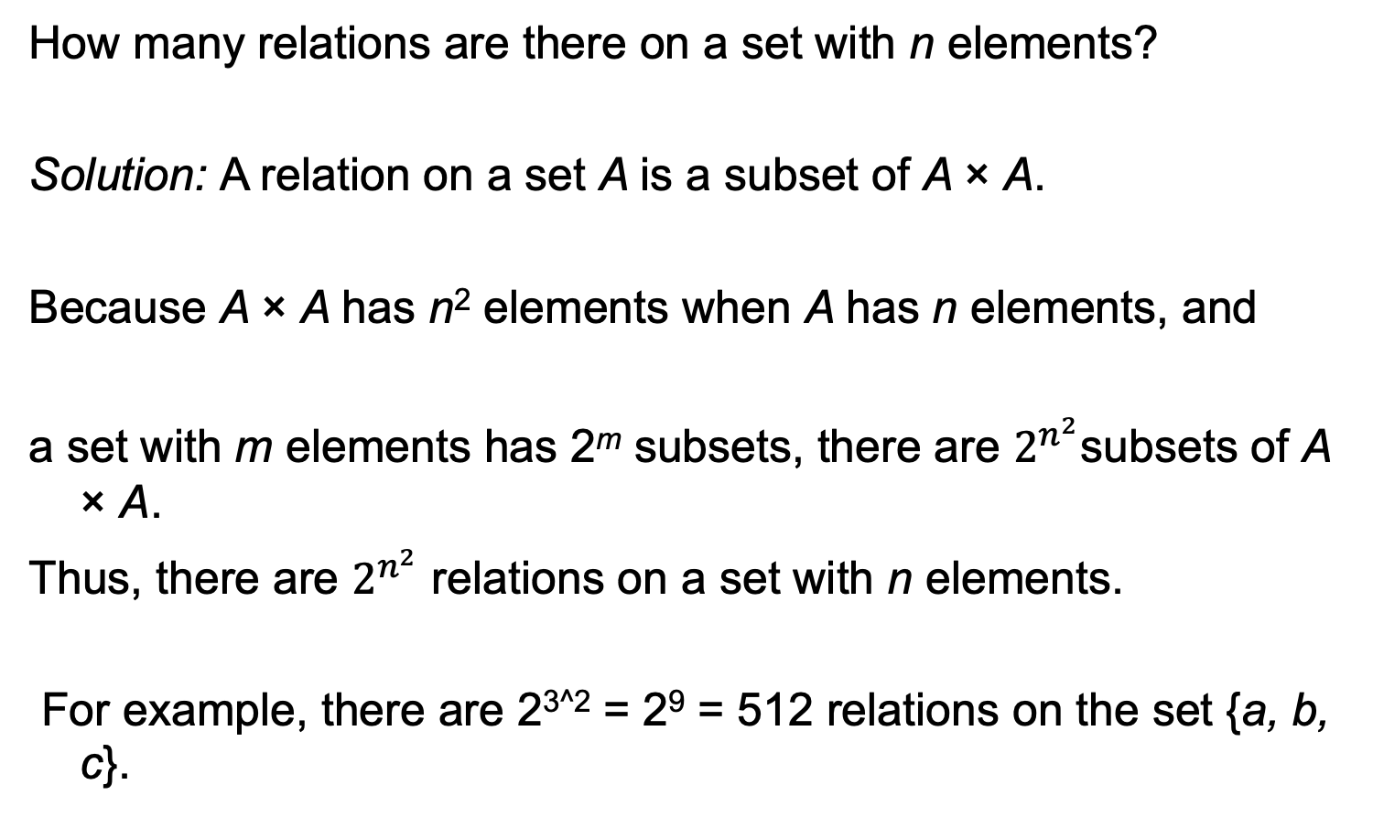
Problem-1
How many relations are there on a set with n elements?
Solution: A relation on a set A is a subset of A × A.
Because A × A has n² elements when A has n elements, and
a set with m elements has 2^{m} subsets, there are $2^{n^{2}}$subsets of A × A.
Thus, there are $2^{n^{2}}$ relations on a set with n elements.
For example, there are 2^{3^2} = 2⁹ = 512 relations on the set {a, b, c}.

Slide 18
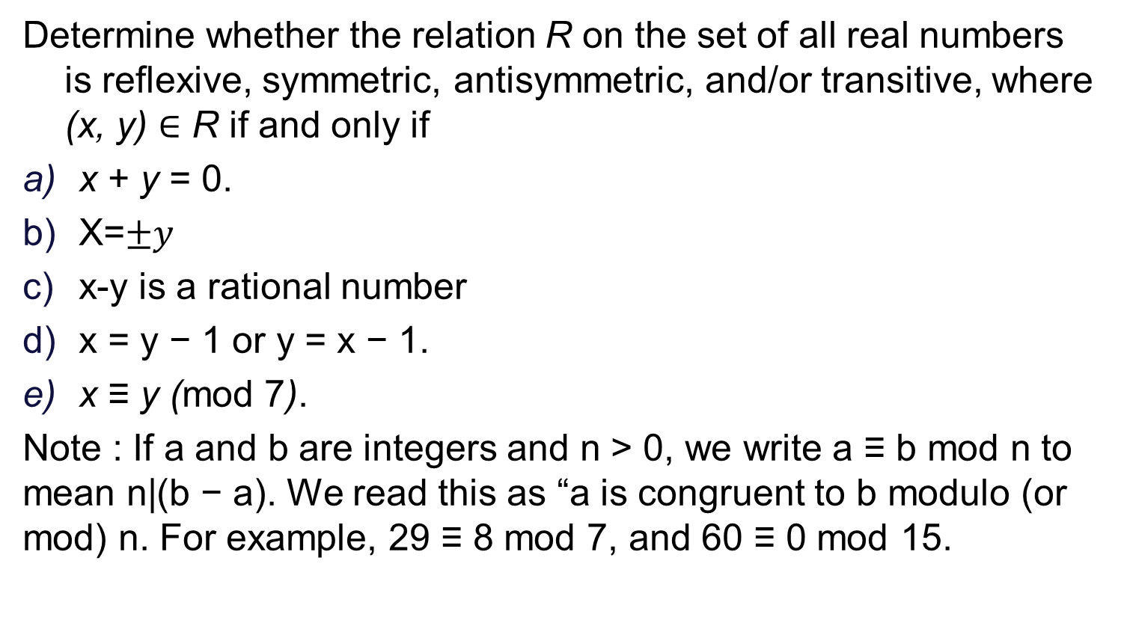
Problem -2
Determine whether the relation R on the set of all real numbers is reflexive, symmetric, antisymmetric, and/or transitive, where (x, y) ∈ R if and only if
x + y = 0.
X=$±y$
x-y is a rational number
x = y − 1 or y = x − 1.
x ≡ y (mod 7).
Note : If a and b are integers and n > 0, we write a ≡ b mod n to mean n|(b − a). We read this as “a is congruent to b modulo (or mod) n. For example, 29 ≡ 8 mod 7, and 60 ≡ 0 mod 15.

Slide 19
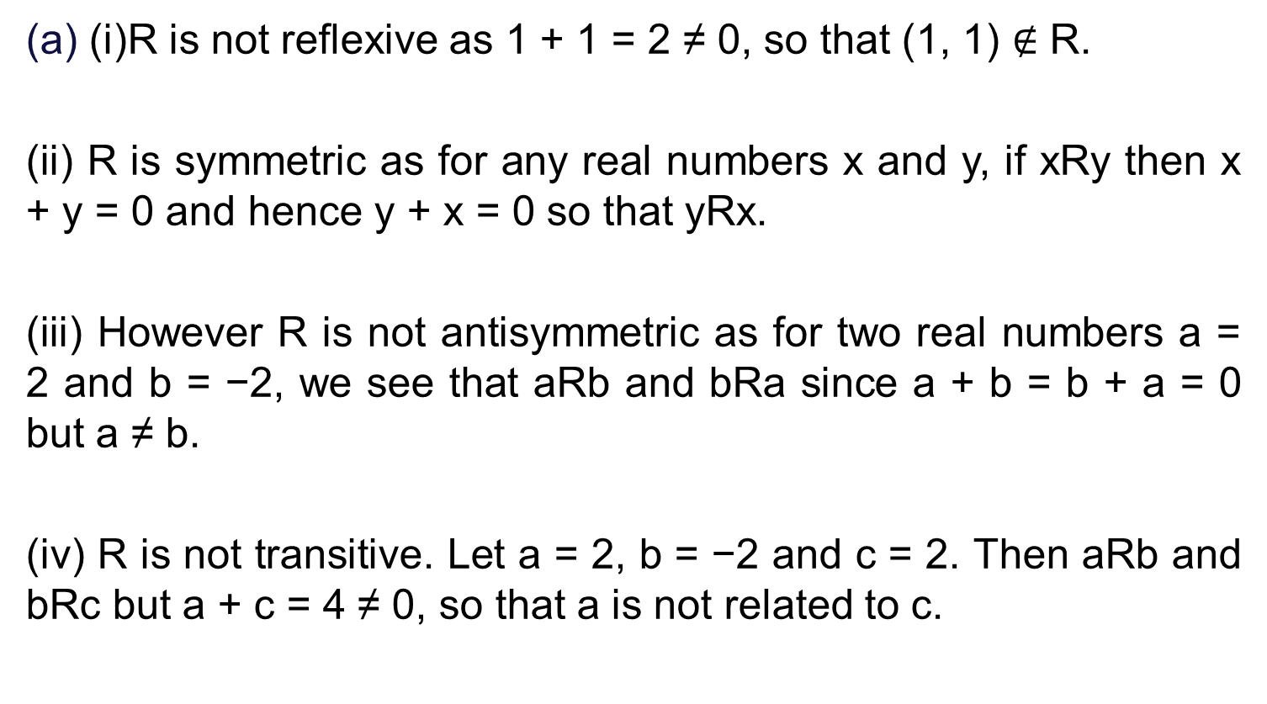
Sol.
(i)R is not reflexive as 1 + 1 = 2 ≠ 0, so that (1, 1) $∉$ R.
(ii) R is symmetric as for any real numbers x and y, if xRy then x + y = 0 and hence y + x = 0 so that yRx.
(iii) However R is not antisymmetric as for two real numbers a = 2 and b = −2, we see that aRb and bRa since a + b = b + a = 0 but a ≠ b.
(iv) R is not transitive. Let a = 2, b = −2 and c = 2. Then aRb and bRc but a + c = 4 ≠ 0, so that a is not related to c.

Slide 20
Sol.
(i)R is reflexive as for any real number x, we have that x = x and hence xRx.
(ii) R is symmetric as for any real number x and y, if xRy then x = ±y and hence y = ±x so that yRx.
(iii) However R is not antisymmetric as for two real numbers x = 2 and y = −2, we see that xRy and yRx since x = −y and y = −x but x ≠ y.
(iv) R is transitive. If xRy and yRz then x = ±y and y = ±z so that x = ±z. Thus xRz

Slide 21
Sol.
(c) (i) R is reflexive as for any real number x, we have that x − x = 0 is a rational number and hence xRx.
(ii) R is symmetric as for any real numbers x and y, if xRy then x − y is rational and hence y − x is also rational so that yRx.
(iii) However R is not antisymmetric as for two real numbers x = 2 and y = −2, we see that xRy and yRx since x − y = 4 and y − x = −4 are both rational but x ≠ y.
(iv) R is transitive. If xRy and yRz then x − y and y − z are both rational and so their sum (x − y) + (y − z) = x − z is also rational. Thus xRz and so R is transitive.

Slide 22
Sol.
(d) We can rewrite the relation R as follows: xRy if and only if |x − y| = 1.
(i)R is not reflexive as for any real number x, we have that |x − x| ≠ 1 so that x is not related to x.
(ii) R is symmetric as for any real numbers x and y, if xRy then |x − y| = 1 and so |y − x| = |x − y| = 1 so that yRx.
(iii) However R is not antisymmetric as for two real numbers x = 1 and y = 0, we see that xRy and yRx since |x − y| = 1 and |y − x| = 1 but x ≠ y.
(iv) R is not transitive. In fact, we take x = 1, y = 0 and z = 1. Then |x − y| = 1 and |y − z| = 1 but |x − z| = ≠ 1. Thus xRy and yRz but x is not related to z.

Slide 23
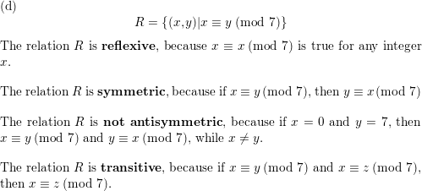
Sol.

Slide 24

Problem
Let R be the relation R = {(a, b) | a < b} on the set of integers.
Find a) R⁻¹. b) $\overline{R}$.

Slide 25
Let R = {(1, 1), (2, 1), (3, 2), (4, 3)}. Find the powers R^{n}, n = 2, 3, 4, . . . .
Solution: Because R² = R ◦R,
R² = {(1, 1), (2, 1), (3, 1), (4, 2)}.
R³ = R2 ◦R, R3 = {(1, 1), (2, 1), (3, 1), (4, 1)}.
R⁴ is the same as R³, R⁴ = {(1, 1), (2, 1), (3, 1), (4, 1)}.
R^{n} = R³

Slide 26
Let R1 and R2 be the “divides” and “is a multiple of” relations on the set of all positive integers, respectively. That is,
R1 = {(a, b) | a divides b} and
R2 = {(a, b) | a is a multiple of b}.
Find
a) R1 ∪ R2. b) R1 ∩ R2.
c) R1 − R2. d) R2 − R1.
e) R1 ⊕ R2.

Slide 27
Let R be a symmetric relation. Show that R^{n} is symmetric for all positive integers n.
Let R be a symmetric relation on set A
Proof by induction:
Basis Step: R1= R is symmetric is True.
Inductive Step: Assume that R^{n} is symmetric.
To Prove that R^{n+1} is symmetric.
R^{n+1} is symmetric if for all (x, y) in R^{n+1}, we have (y, x) is in R^{n+1} as well.
Assume that (x, y) is in R^{n+1}. Now, R^{n+1} = R^{n}oR = RoR^{n}

Slide 28
Cont.
We know that if (x, y) ∈ RoR^{n}, then by the definition of composition there exists a z in A such that xRz and zR^{n}y i.e (x, z) is in R and (z, y) is in R^{n.}
And we also know that R and R^{n} are symmetric, which implies that (z, x) is in R and also (y, z) is in R^{n}.
Therefore, by definition of composition, (y, x) ∈ RoR^{n};
i.e.; (y, x) ∈ R^{n+1}.
Hence Proved.

Slide 29
N-Array relation
Let A₁,A₂, . . . , A_{n} be sets. A_{n} n-ary relation on these sets is a subset of A₁ × A₂ ×・ ・ ・×A_{n}.
The sets A₁, A₂, . . . , A_{n} are called the domains of the relation, and n is called its degree.
A database consists of records, which are n-tuples, made up of fields. The fields are the entries of the n-tuples.
The relational data model represents a database of records as an n-ary relation.

Slide 30
Relation as a database
Relations used to represent databases are also called tables, because these relations are often displayed as tables.
Each column of the table corresponds to an attribute of the database.
For instance, the same database of students is displayed in Table 1. The attributes of this database are Student Name, ID Number, Major, and GPA.
A domain of an n-ary relation is called a primary key when the value of the n-tuple from this domain determines the n-tuple.
That is, a domain is a primary key when no two n-tuples in the relation have the same value from this domain.

Slide 31
Definition
Let R be an n-ary relation and C a condition that elements inR may satisfy. Then the selection operator s_{C} maps the n-ary relation R to the n-ary relation of all n-tuples from R that satisfy the condition C.
The projection P_{i1i2,...,im} where i₁ < i₂ < ・ ・ ・ < i_{m}, maps the n-tuple (a₁, a₂, . . . , a_{n}) to the m-tuple (a_{i1} , a_{i2}, . . . , a_{im}), where m ≤ n.

